Slide 1

Week 2: Turn-taking
Ryan Ka Yau Lai
University of California, Santa Barbara

Slide 2
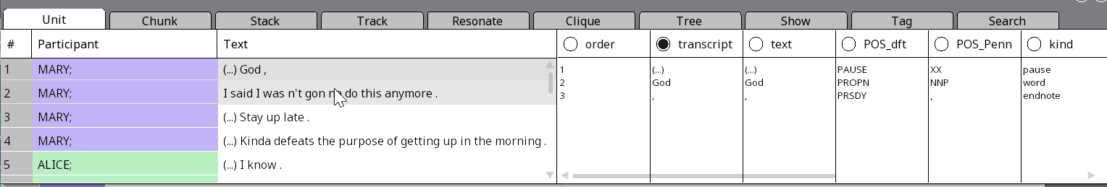
While we’re waiting …
Open SBC007 on Rezonator
Open the audio file
Change active display to the transcript field
Note today’s codeword and question on the board
Shameless plug: You can enroll in LING 194 Visualising language in conversational interactions, which I teach in summer!

Slide 3

Question for today
Give one example of a backchannel from SBC001, 002 or 007, and explain how it performs a floor-holding function.

Slide 4
Goals for today
Understand
Understand the goals of researching turn-taking
Identify
Identify backchannels and describe their uses
Use
Use the turn stacker in Rezonator and merge turns
Learn
Learn to identify evidence from conversation
Distinguish
Distinguish between different types of overlaps in conversation
Revise
The concepts of TCUs and TRPs, and how they apply to the data (time permitting)

Slide 5
Turns again …
We will keep revising the concepts of turns this quarter
For now, a ‘turn’ is a segment of speech where one person is the one speaking, and other people are listening
The person speaking has the floor

Slide 6

Turn-taking: The big questions
When we speak, overwhelmingly one person speaks at a time
We avoid talking simultaneously
We avoid awkward silences
When we interact, we must somehow determine who speaks and when
So how do we determine this? Perhaps there are hidden social rules that we all follow …

Slide 7

The ‘hidden rules’ of conversation
Perhaps…
We don’t start speaking in the middle of someone else’s sentence
We speak if someone asks us a question
We can speak if someone finishes telling a story
This is the type of rules we will be examining …

Slide 8

Backchannels
yeah, right, mhm
a.k.a. continuer (in this course the difference is not so important)
Used to express that you understand what the other person is saying and align with them without taking the floor from them
A floor-holding device (i.e. a way of letting the current speaker keep the floor)
‘Hidden rule’: If someone is speaking, then other people can produce a backchannel in appropriate places. In that case, the original speaker is expected to continue their turn!

Slide 9
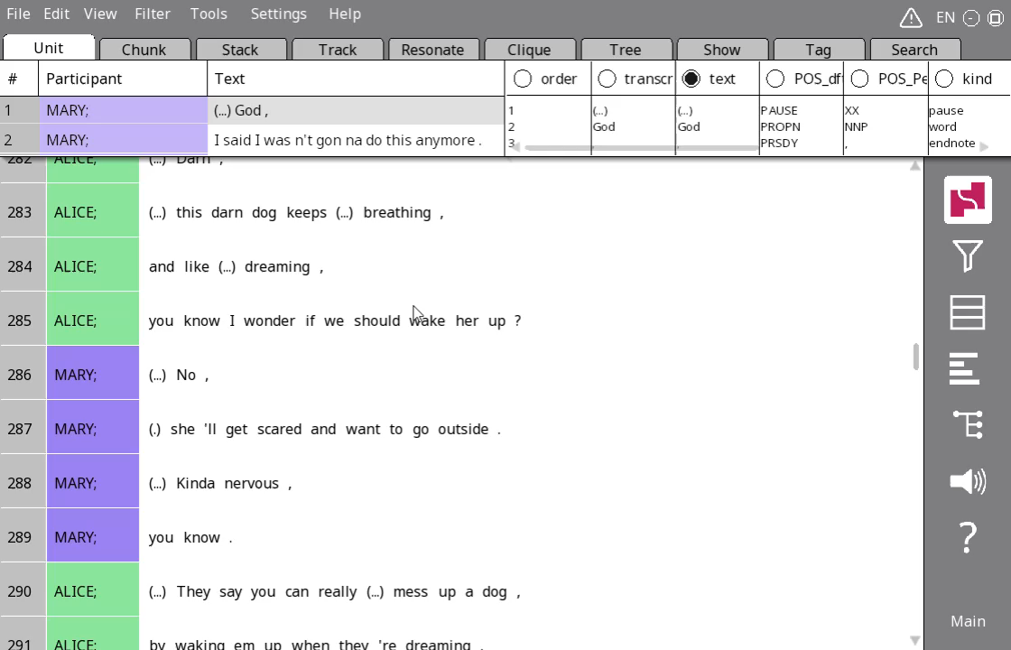
Quick stacks
There are multiple ways to create stacks
In this class, we will use the easiest way (drag-and-drop)
Click on the first unit, then drag to the last unit of the intended stack
To make a second stack, exit the current one with your Esc key, or click on a white area of the screen

Slide 10
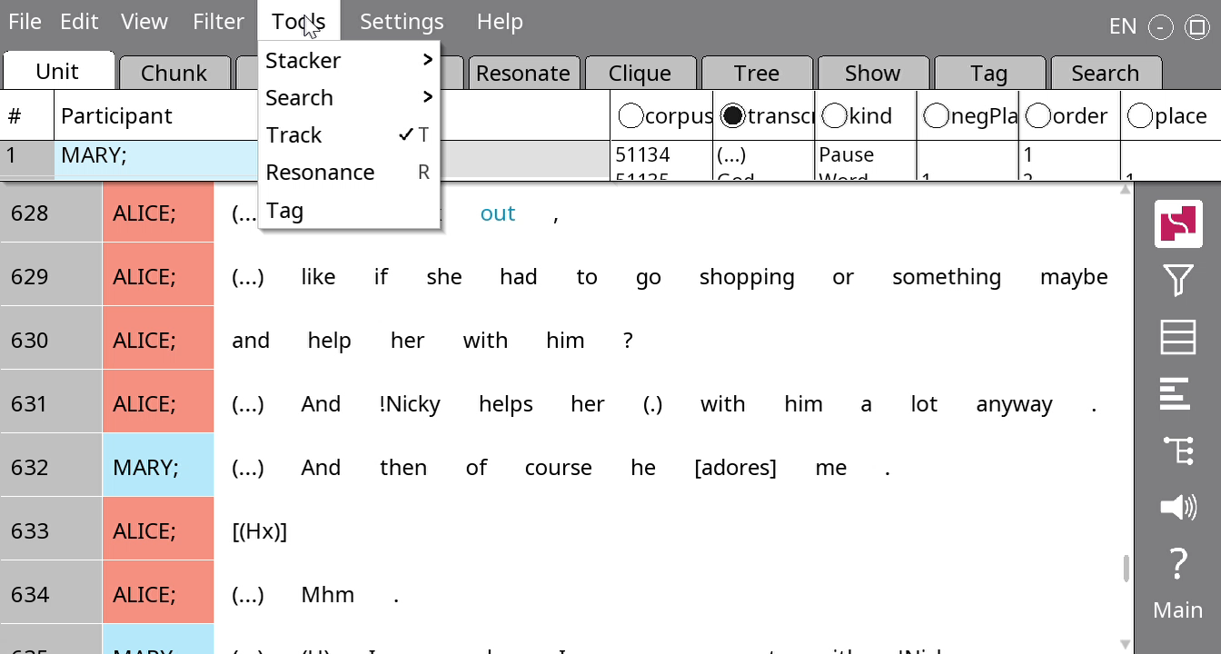
The turn stacker
Click Tools > Stacker > From participant labels, and type Turn
The turn stacker determines turns by changing turns every time the participant label changes. What might be a problem with this?

Slide 11
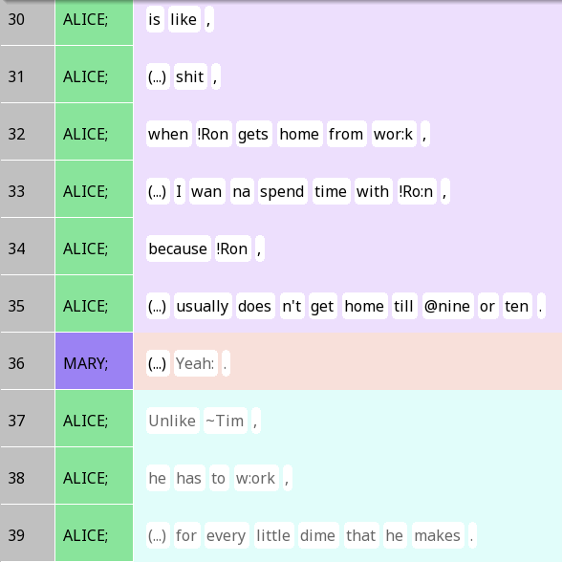
Backchannels and turn changes
Any reason you might want to change the turns here?

Slide 12
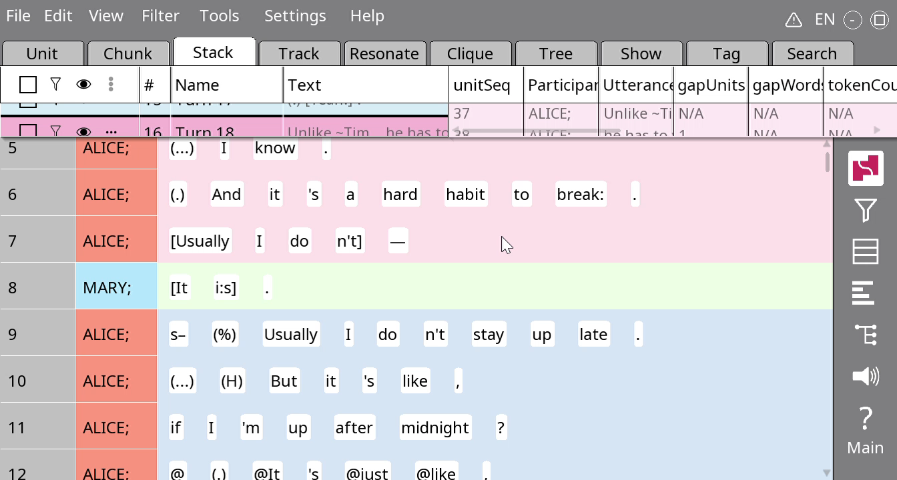
Merging turns
Click on the ‘swallowing’ turn
Hold the CTRL button
Click on the ‘swallowed’ turn
Press OK

Slide 13

Your turn!
Tip: The audio and transcript field are your friends!
Note: You can work on your attendance question during this activity.
Try to turn the stacks into more meaningful turns in ~100 lines of Rezonator
Discuss with your friends:
In what situations do you need to merge turns?
What do you notice about the lengths of turns (in units)?

Slide 14
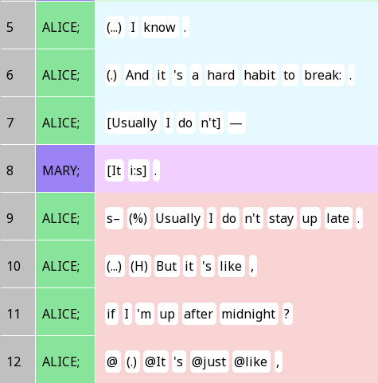
Overlap
At the end of line 6, Alice finished a sentence – it is a ‘possible turn completion’ (it is possible for her to stop speaking) or transition-relevance place (TRP)
She didn’t stop speaking (line 7), but Mary didn’t realise this and started speaking at the same time (line 8)
How might you change the turns here?

Slide 15

Behaviour vs. system
Mary and Alice spoke at the same time – something they want to avoid
They behaved in a way that deviates from the turn-taking ideal
But both of them were following the ‘hidden rules’ of conversation – Line 7/8 were just ambiguous as to what they should do!

Slide 16
Assignment 1
In assignment 1, you will compare SBC001 and SBC002
The people have very different behaviour
But this does not mean the ‘hidden rules’ of their conversation are different
Can you identify similar ‘hidden rules’ in the two texts, despite their differences?

Slide 17
Identifying evidence from inside the conversation
It is often tempting to attribute differences in behaviour to factors like personality (Lynne is more domineering / talkative etc.)
However, we have no evidence of people’s personality – we only have the conversations in front of us
Look in the conversation for examples of …
Epistemic authority (who knows their stuff more?)
Differences in social relationships (any evidence that people are closer in one text, and therefore more tempted to chime in?)

Slide 18
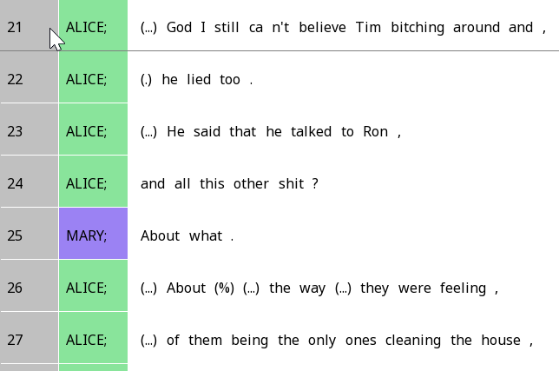
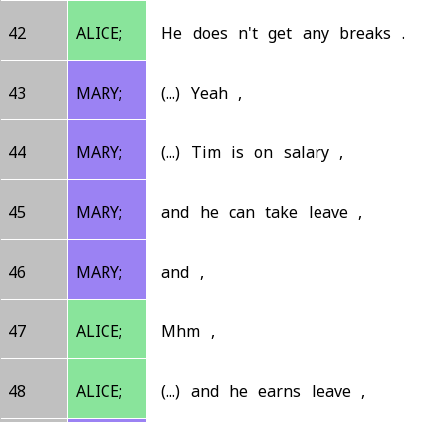
Evidence of epistemic authority (using SBC007)
In the beginning of SBC007, Alice is talking about her roommates
She tends to talk more in the conversation since only she knows about those recent incidents
However, Mary has a plenty of background info about those roommates, so she often adds commentary

Slide 19
Evidence of social relationships (using SBC007)
It is apparent from some of their conversation that they have a lot of shared information
In fact, if you read on, you will find out they are sisters
Since they know a plenty of things about each other, they often find occasions to e.g. complete each other’s sentences

Slide 20
Quick tips on assignment
Remember to read through the rubrics
Much of the score is based on clear presentation – this is the easy part!
Give context before presenting examples, and explanation afterwards
When presenting Rezonator screenshots, present all and only content that is relevant to your discussion
The first assignment will be challenging, even for folks who have taken LING 124. Don’t be discouraged by it – it will get better throughout the quarter (as those who have taken 124 can attest)!

Slide 21
Overlaps
There are many of them especially in SBC002
Recognisable by brackets: [ ]
Important to understand where and why overlap is happening

Slide 22
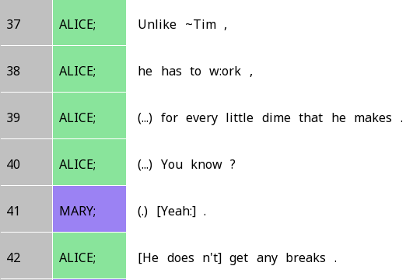
Transition-space overlap
The overlap we just saw is called transition-space overlap
Because it happened at a place where a new turn could potentially start
Also common with backchannels in English

Slide 23
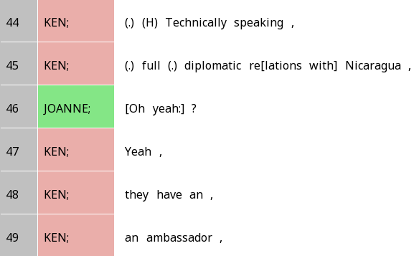
Interjacent overlap
You jump in when the other person clearly hasn’t finished
‘Diplomatic re…’ is clearly not the end of Ken’s turn
But Joanne jumps in anyway because she challenges Ken
Which of these two types of overlap is more likely to be seen as ‘impolite’ or an ‘interruption’?

Slide 24
Competitive vs non-competitive overlap
Competitive overlap: Two people are ‘fighting’ over who has the floor
Doesn’t have to be nasty or involve hard feelings
Non-competitive overlap: No fighting over who has the floor
Is interjacent overlap usually competitive or non-competitive?
When backchannel overlaps with speech, is that usually competitive or non-competitive?

Slide 25
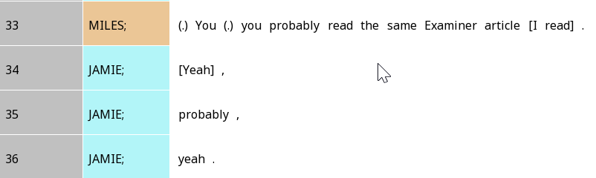
Transition-relevance places
Where a TCU can be interpreted as complete, even if it is not actually complete
We often find unintended overlap at TRPs

Slide 26

Turn construction units (TCU)
(Roughly) a stretch of discourse over which you complete a social action
Traditionally defined in terms of syntactic (grammatical) units
Each TCU can be a turn on its own
But doesn’t have to be

Slide 27
TCUs and the ‘hidden rules’ of conversation
We produce language one TCU at a time
Traffic analogy: TCUs are cars, turn-taking system is the traffic rules that determine how TCUs go
A TCU is the minimal amount of language we have to say, for us to finish the social action we intend to perform
So when we speak, we aim to at least finish the first TCU
And typically would not stop before the first TCU
(which doesn’t mean we don’t, of course …)

Slide 28
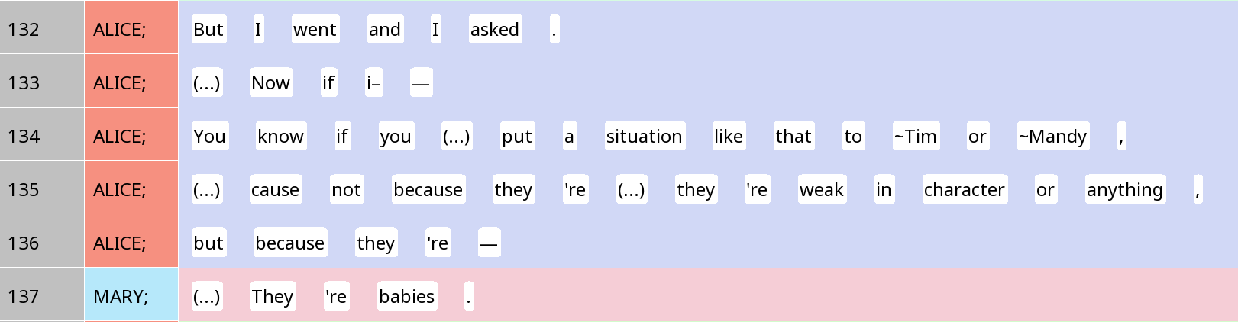

A TCU can be big, e.g. a clause (with subject, verb, object)

Slide 29
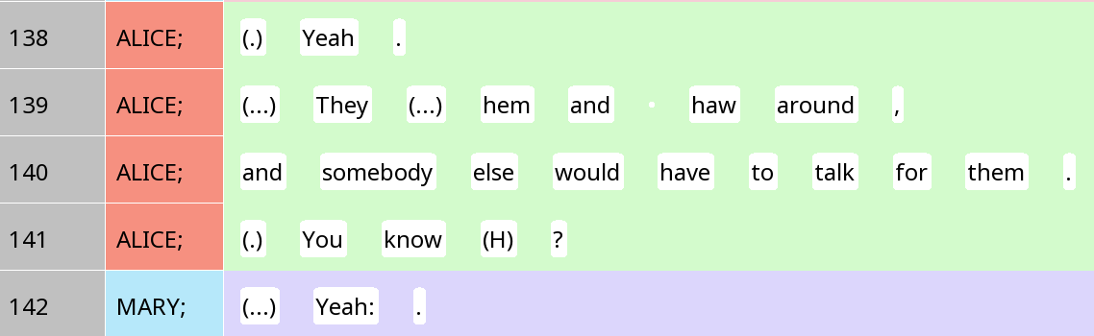
A TCU can be small, a single word (in this case, an interjection)

Slide 30
Turn-taking
Typical situation: One TCU in one turn
But we often produce multi-unit turns
Situation 1: The original social action does not see immediate uptake from the other person, so we add something to it
Situation 2: We are telling a long story, giving a long description, etc.
Often we signal this in some way, e.g. using ‘well’ – projects a multi-unit turn
Often happens in SBC001!
If you hear a silence between two TCUs, and the first TCU clearly asks for someone else to respond, what situation might this be?

